Slide 1
Microsoft MakeCode: from C++ to TypeScript and Blockly (and Back)
C++ Users Group Meeting
April 2018
Notes:
Title
Microsoft MakeCode: from C++ to TypeScript and Blockly (and Back)
Speaker
Thomas Ball, Principal Researcher, Microsoft Research
http://research.microsoft.com/~tball/
Abstract
Across the globe, it is now commonplace for educators to engage in the making (design and development) of embedded systems in the classroom to motivate and excite their students. This new domain brings its own set of unique requirements. Historically, embedded systems development requires knowledge of languages such as C and C++, local installation of compilation toolchains, device drivers and applications. For students and educators, these requirements introduce unnecessary barriers and restrictions.
Over the last two years, Microsoft has invested in a new web-based programming platform for embedded systems in education, called Microsoft MakeCode (www.makecode.com), in partnership with Lancaster University, who created the C++ Component-oriented Device Abstraction Layer (https://github.com/lancaster-university/codal). In this talk, I’ll describe the design principles behind MakeCode and CODAL and our experience with it to date. In particular, I’ll describe how our stack exposes C++ in the browser via TypeScript and Blockly programming APIs, with an in-browser compiler tool chain that produces executable files without the need for a C++ compiler in the core end-user experience. MakeCode is open source at http://github.com/microsoft/pxt
Bio
Thomas (Tom) Ball is a principal researcher and manager at Microsoft Research. In 1999, He initiated the influential SLAM software model-checking project with Sriram Rajamani, which led to the creation of the Static Driver Verifier tool for finding defects in Windows device drivers. Tom is a 2011 ACM Fellow for ‘contributions to software analysis and defect detection’. As a manager, he has nurtured research areas such as automated theorem proving, program testing/verification and empirical software engineering. His current focus is the Microsoft Makecode platform for programming with physical computers.

Slide 2
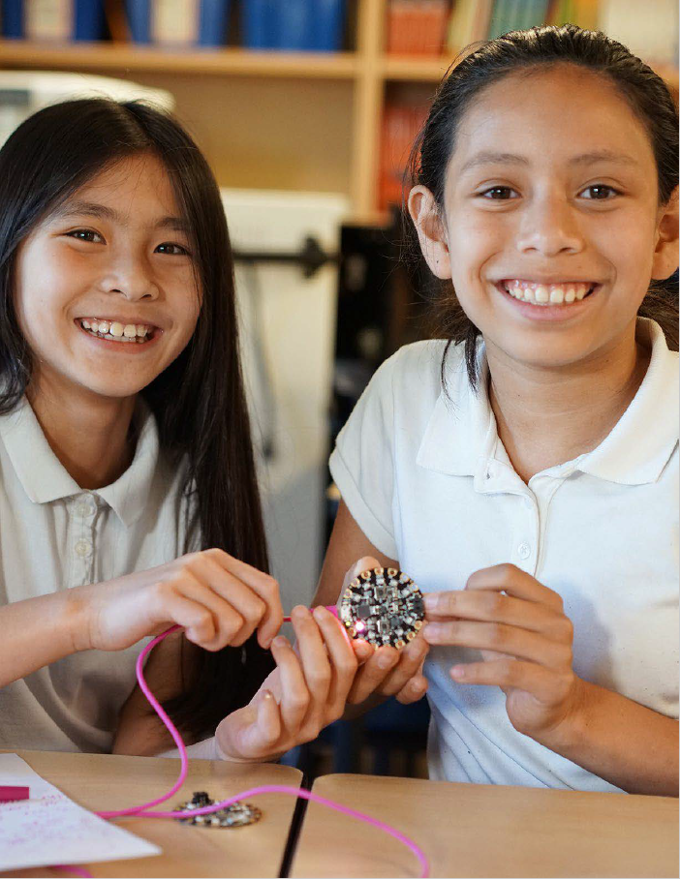

Microsoft MakeCode Hands-on Computing for every student
Just works always, everywhere
Physical computing a more inclusive approach to CS education
Path to real-world skills
Extensible platform for partners

Slide 3
Microsoft MakeCode Objectives
Usage – Increased diversity and number of students engaged/interested in computing and technology
Brand – Microsoft recognized as an innovator in computing education
Ecosystem – Democratizing access to the world of intelligent edge devices and enabling a thriving partner ecosystem

Slide 4
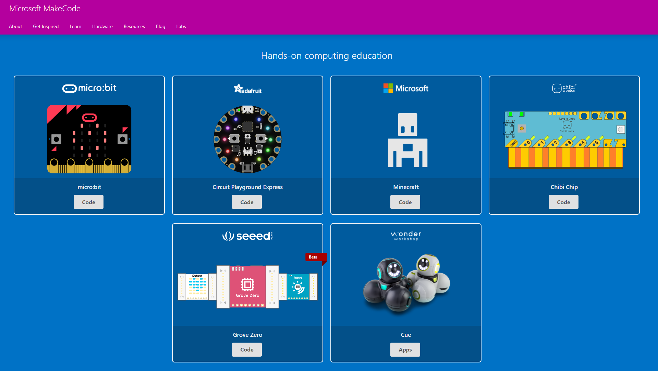
www.makecode.com

Slide 5
Principles
Simple to make and code with physical computers
Blocks -> JavaScript (via TypeScript)
Go to where teachers/students are today:
ChromeBooks
iOS, Android (phones, tablets)
Windows, MacOS, Linux, …
Progression to:
wider world of programming languages
richer physical computing ecosystem (IoT, …)
the cloud, data science, machine learning, …

Slide 6
Innovations
Web app for end-to-end experience
no install or need for C/C++ compiler for end-user
in-browser compilation to binary
TypeScript as core language
API mapping: up to Blockly and down to C++
coverage of OO concepts
Runtime abstractions
Events, message bus and co-routines
support concurrent, reactive programming
Blockly
TypeScript
C++
Notes:
web based editor: nothing to install
cross platform: works in most modern browsers from tiny phone to giant touch screens
compilation in the browser: the compiler runs in your browser, it's fast and works offline
blocks + JavaScript: drag and drop blocks or type JavaScript, MakeCode let's you go back and forth between the two.
works offline: once you've loaded the editor, it stays cached in your browser.
event based runtime: easily respond to button clicks, shake gestures and more

Slide 7
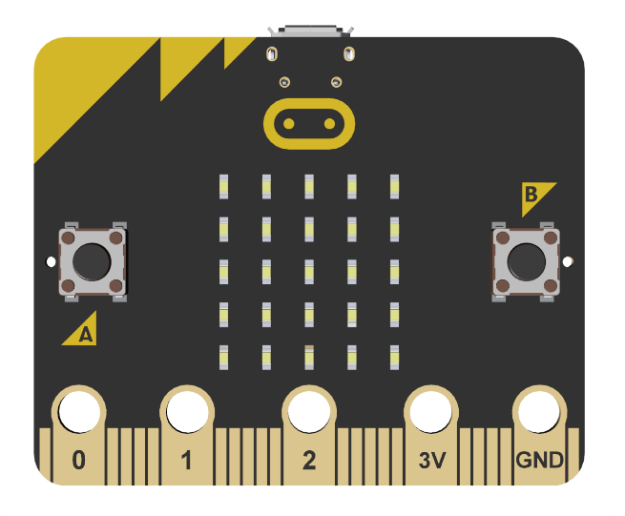
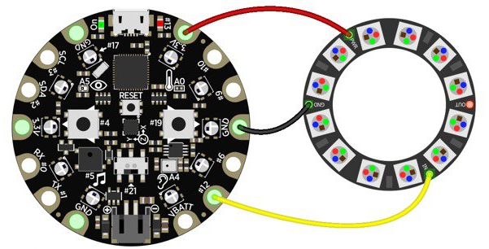
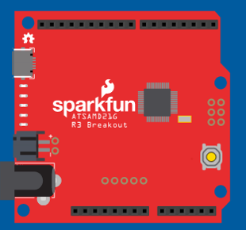
MakeCode and CODAL
makecode.microbit.org
maker.makecode.com
Web sites
makecode.adafruit.com
Blockly and JavaScript Editors
TypeScript
Web app
Simulator
Compiler
CODAL/STS Runtime
Devices

Slide 8
Editors
Simulator
Web App
Blockly
JavaScript
TypeScript
Metadata generation
Browser compilation
Monaco
Static TypeScript
IR
Assembly
user
binary
TypeScript
Device
runtime
Linker
Static
TypeScript
runtime
binary
cached copy
Shim generation
final binary
C++
runtime
binary
compile
Cloud compilation
decompile
link

Slide 9
TypeScript
Gradually typed superset of JavaScript
Compiles to JavaScript
Supports ECMAScript 2015 and latest language features
Types enable productivity tools
intellisense, navigation, refactoring
http://www.typescriptlang.org/

Slide 10
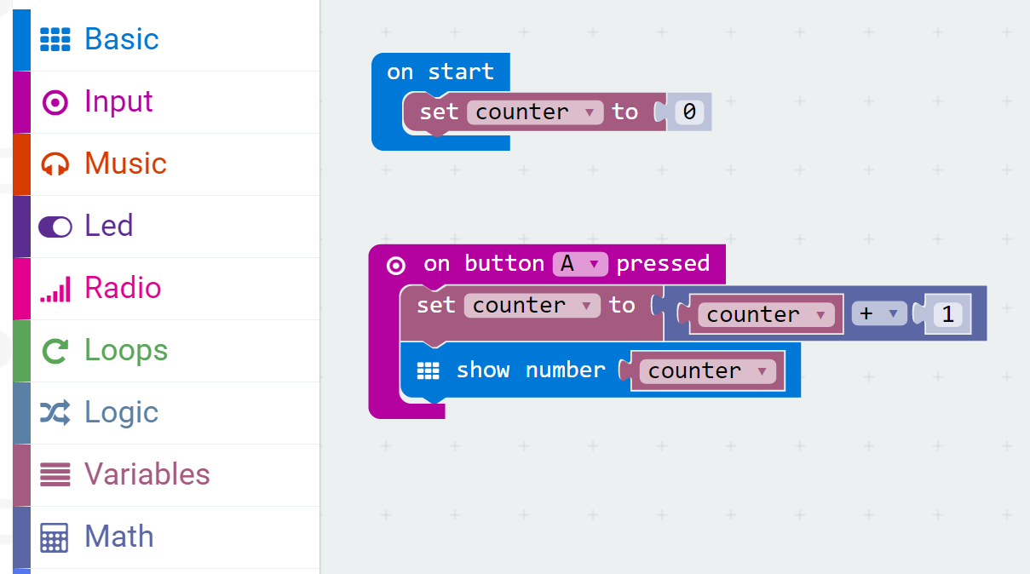
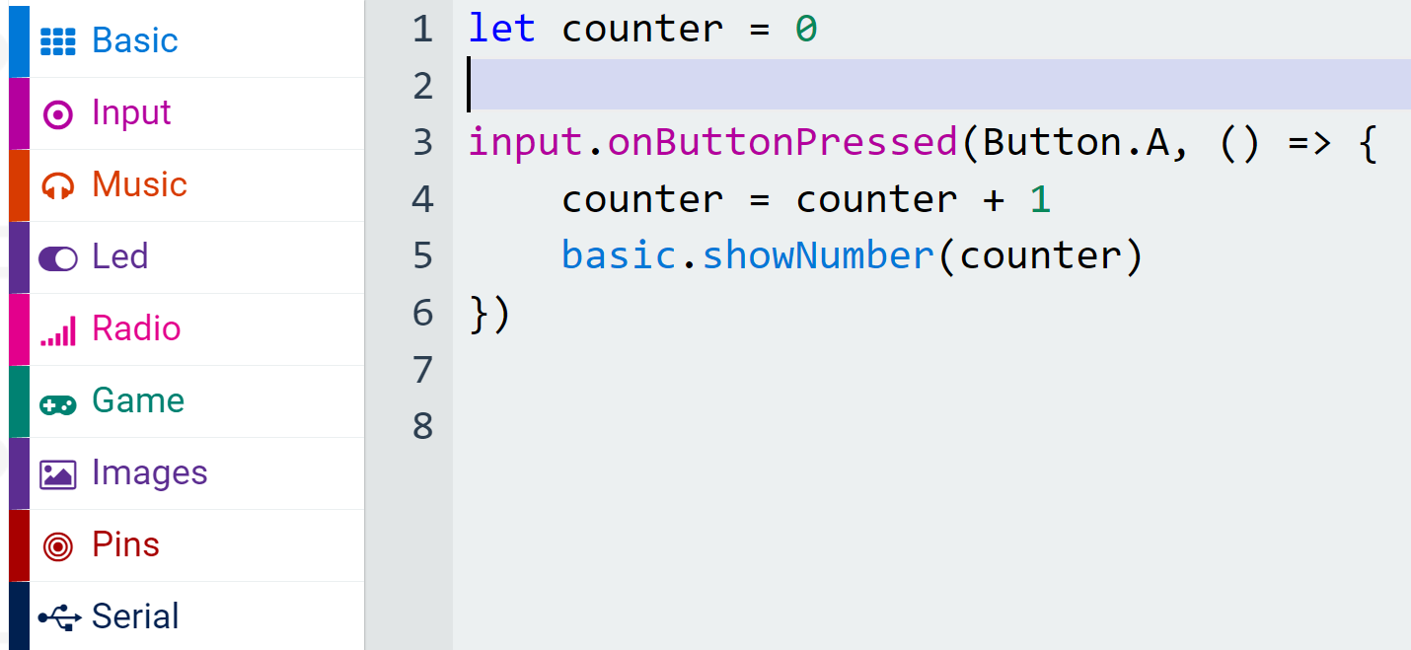
Blocks and TypeScript
Blockly
TypeScript
Categories
Namespaces

Slide 11
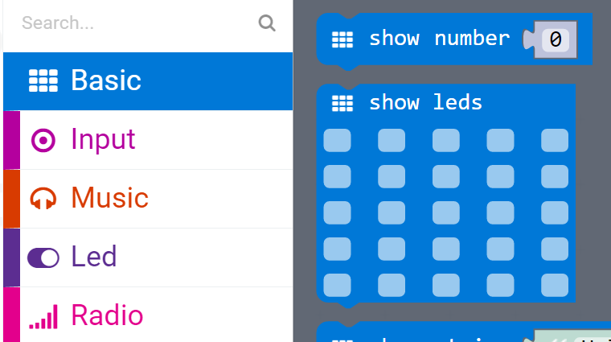
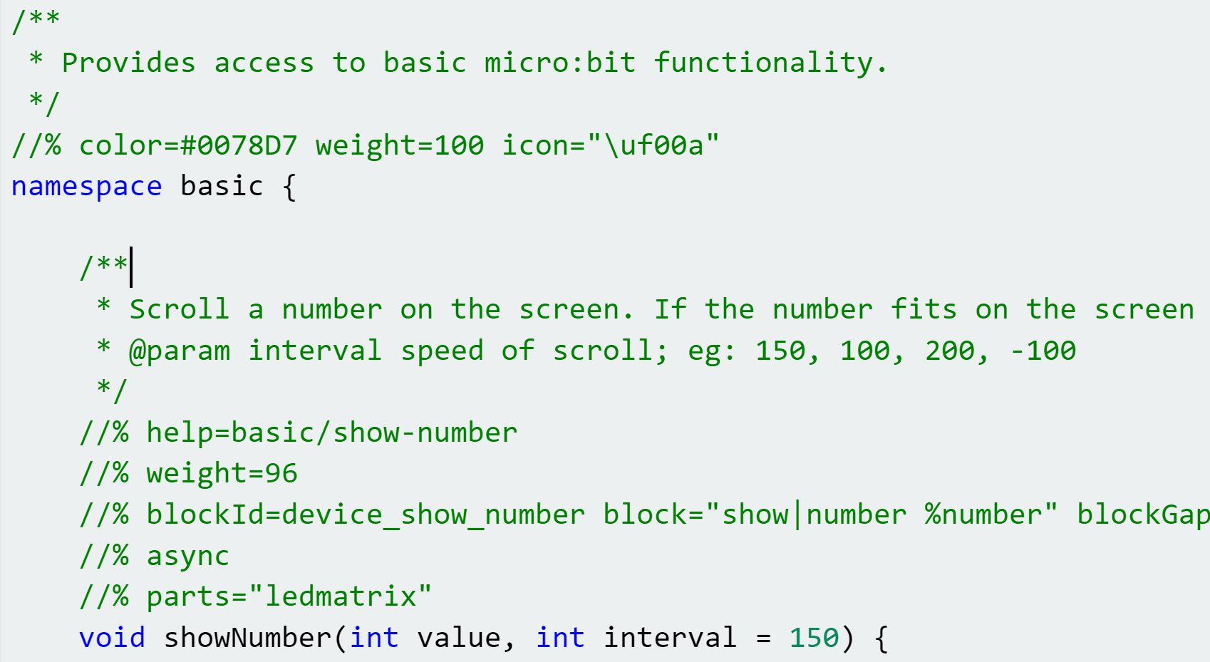
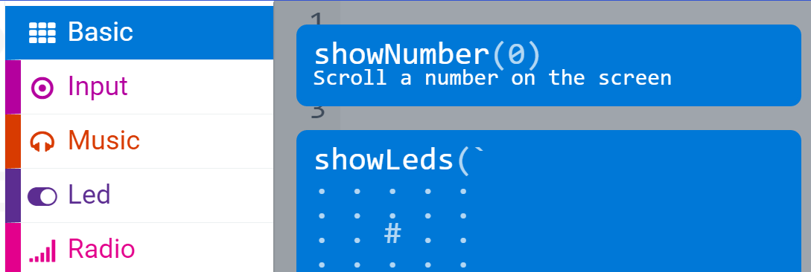
API Binding (1)
Blockly
C++
TypeScript

Slide 12
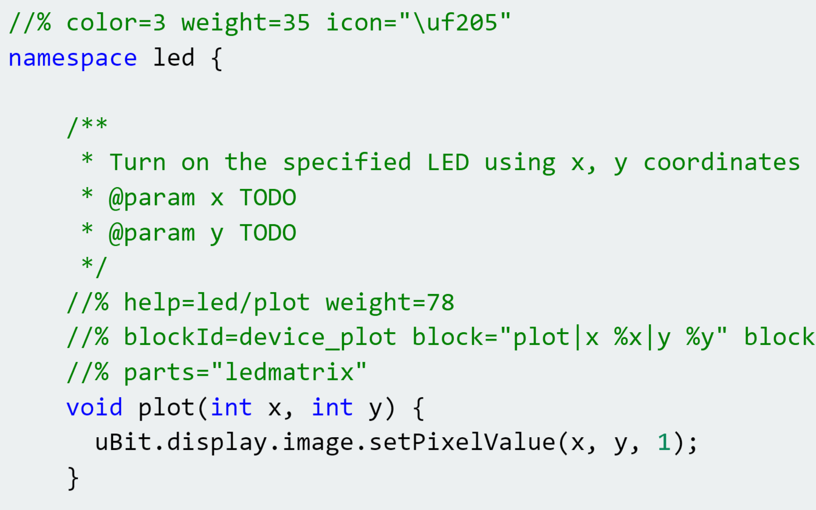
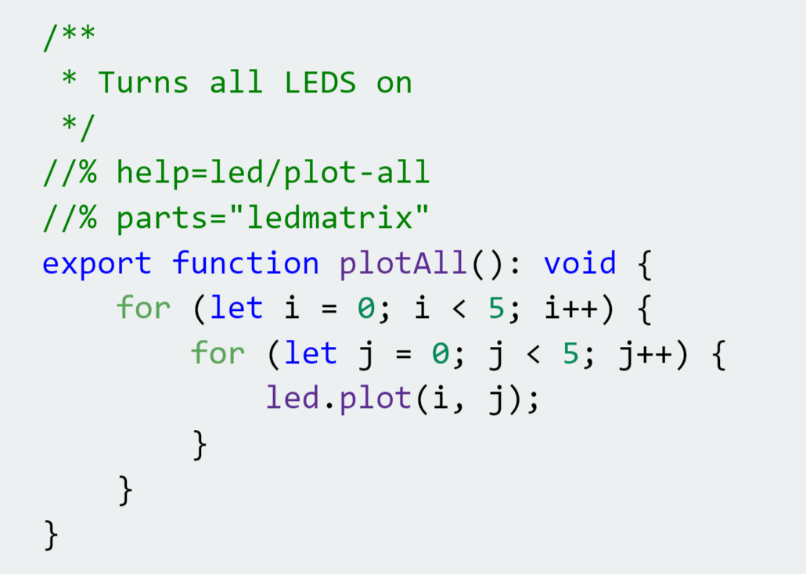
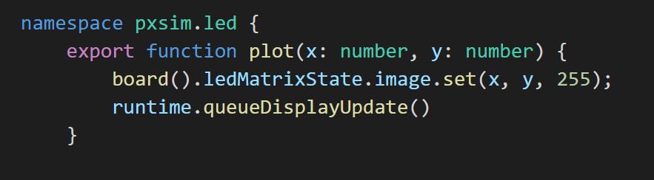
API Binding (2)
C++ wrapper to micro:bit runtime
TypeScript runtime extension
TypeScript simulator implementation

Slide 13
MakeCode and C++
Compiling and linking (Static) TypeScript against precompiled C++
CODAL: Component-oriented Device Abstraction Layer
pxt-common-packages
Glue between CODAL and MakeCode
Provide standardization of TypeScript and Blockly for common device features

Slide 14
Compiling C++ for MakeCode
//% comment
marks C++ functions to expose via a function table to MakeCode
MakeCode mapping between Static TypeScript and C++ types
No sharing of classes between C++ and STS

Slide 15
codal-core
Blockly,
Typescript, Monaco
pxt
uses
references
extends,
implements
codal-atmega328p
pxt-common-packages
references
uses
codal-arduino-uno
uses
codal
(build shell)
uses
pxt-target
extends,
implements
codal-samd21
selects from
uses
codal-circuit-playground
MakeCode web app
Notes:
https://github.com/lancaster-university/codal-adafruit-cplay

Slide 16
MakeCode GitHub repos (1)
Framework and support
https://github.com/Microsoft/pxt
https://github.com/Microsoft/pxt-blockly
https://github.com/Microsoft/pxt-monaco-typescript
https://github.com/Microsoft/pxt-common-packages (CODAL-specific)
Targets
https://github.com/Microsoft/pxt-adafruit
https://github.com/Microsoft/pxt-chibitronics
https://github.com/Microsoft/pxt-microbit
https://github.com/Microsoft/pxt-maker

Slide 17
MakeCode GitHub repos (2)
Packages (primarily for micro:bit)
https://github.com/Microsoft/pxt-neopixel
https://github.com/Microsoft/pxt-max6675
https://github.com/Microsoft/pxt-sonar
https://github.com/Microsoft/pxt-bluetooth-midi
https://github.com/Microsoft/pxt-gestures
https://github.com/Microsoft/pxt-microturtle

Slide 18
The Web
(browser)
Plentiful RAM
World of great frameworks
for beginning programming
(Blockly)
Web App
JavaScript
Single-threaded
Static TypeScript
our contribution
bringing the worlds of
Web and MCU together
MakeCode = integration/entry point
Languages
Compiler
Runtime
CODAL
Reactive/
concurrent
C/C++
Full bare-metal binary
The microcontroller
(MCU)
Little RAM
World of the pro IDE
(Eclipse, VS, VS Code)

